Slide 1


THE COUNTRY REPORT:
THE GLOBE PROGAMME IN
SRI LANKA
GLOBE Asia Pacific Regional Meeting
Asha De Silva
Assistant Director of Education
Ministry of Education
Sri Lanka
For Country Coordinator Mrs. H.I.D.D Hettiarachchi

Slide 2
Profile
Name : Asha De Silva
Function : For Country Coordinator, Sri Lanka
        Training Assistant
Organization : Ministry of Education
E mail : ashaagrimoe@gmail.com
Telephone No : 094 112177379/ 094 714331545
Whatsapp : 094 714331545

Slide 3
Cooperating Organizations
Provincial Departments of Education (9)
Central Environment Authority
Government Universities
Funded by: General Education Modernization Project
(GEMP), Government of Sri Lanka

Slide 4
Participating Schools
149 schools and 184 teachers
Province | No of schools
Western | 50
Central | 15
Southern | 19
Northern | 9
Eastern | 5
North Western | 16
Uva | 6
Sabaragamuwa | 17
North Central | 12

Slide 5

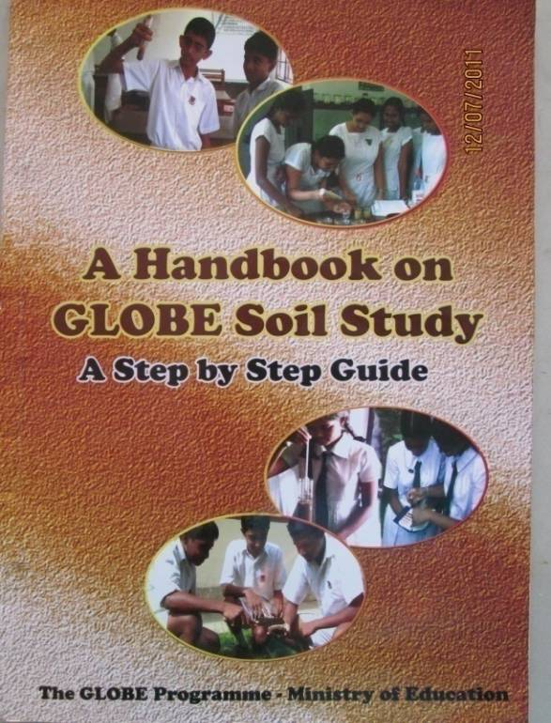
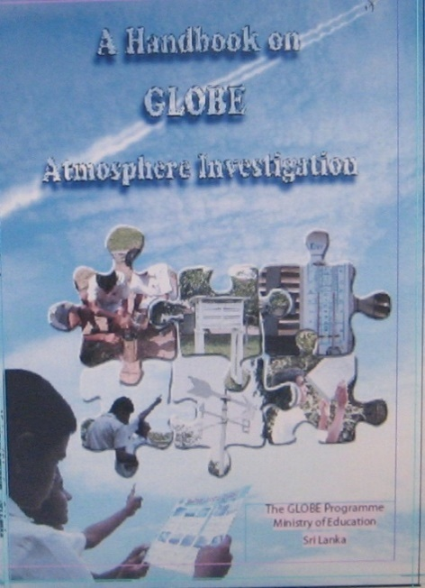

GLOBE Protocols Used In Sri Lanka
  Atmosphere
  Hydrosphere
  Pedosphere
  Biosphere

Slide 6
GLOBE Activities in Sri Lanka
1. Expanding the programme
2. Quality improvement

Slide 7




Online and onsite Students training programmes
Online and onsite teacher training programmes
Capacity building workshop for teachers on student research projects
Education officer training and awareness programmes
Protocols:- Atmosphere Hydrosphere Pedosphere Biosphere
Refresher Training for the GLOBE Teachers
Beginner Training for the newly appointed GLOBE Teachers
Protocols:- Atmosphere Hydrosphere Pedosphere Biosphere
Protocols:- Atmosphere Hydrosphere Pedosphere Biosphere

Slide 8
2. Quality improvement of the programme
Appointing regional monitoring officers to monitor the GLOBE programme
Student project evaluation programme under Sustainable development programme
Environmental pioneer programme
Tree planting programmes
Establishment of School farms programme

Slide 9
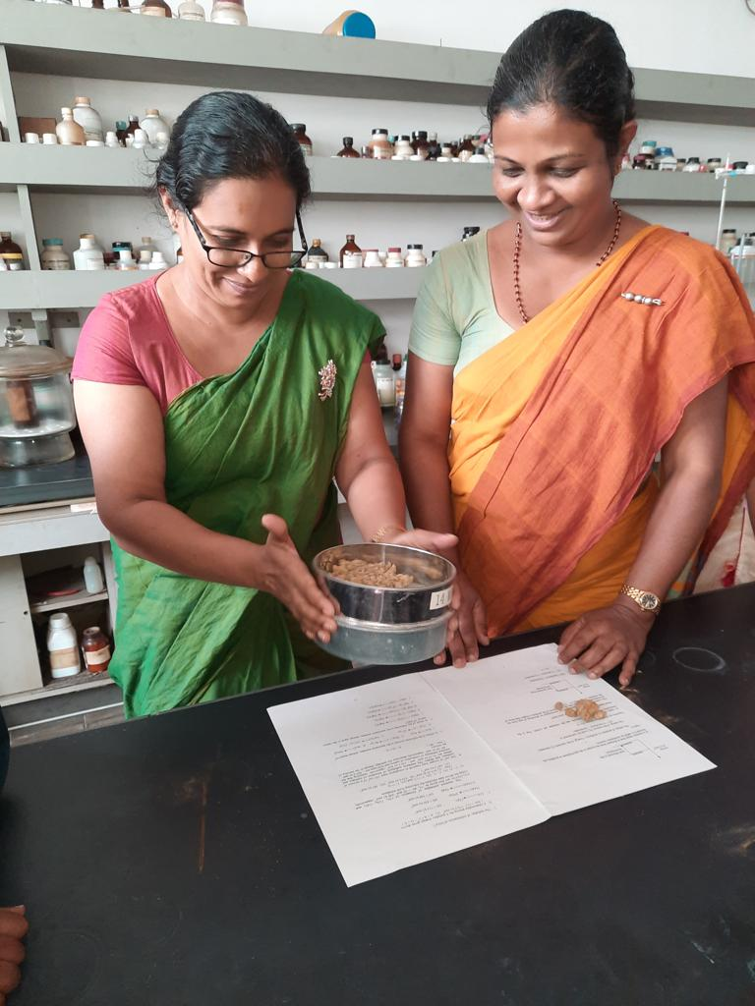
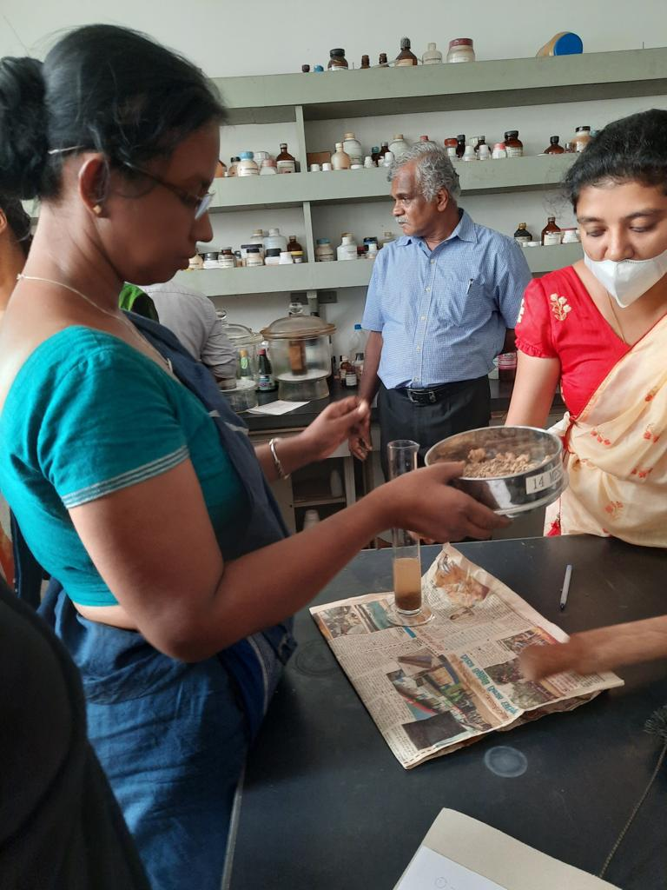
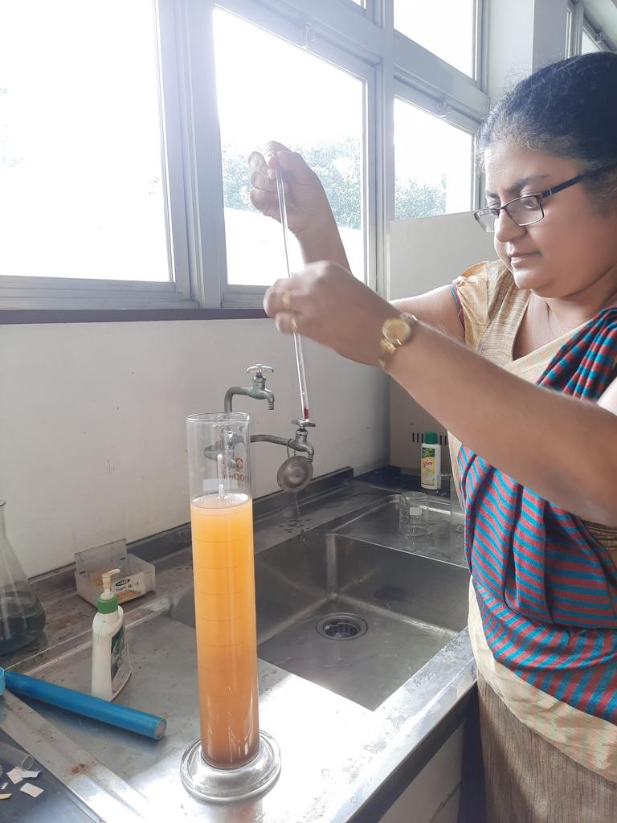
Pedosphere

Slide 10
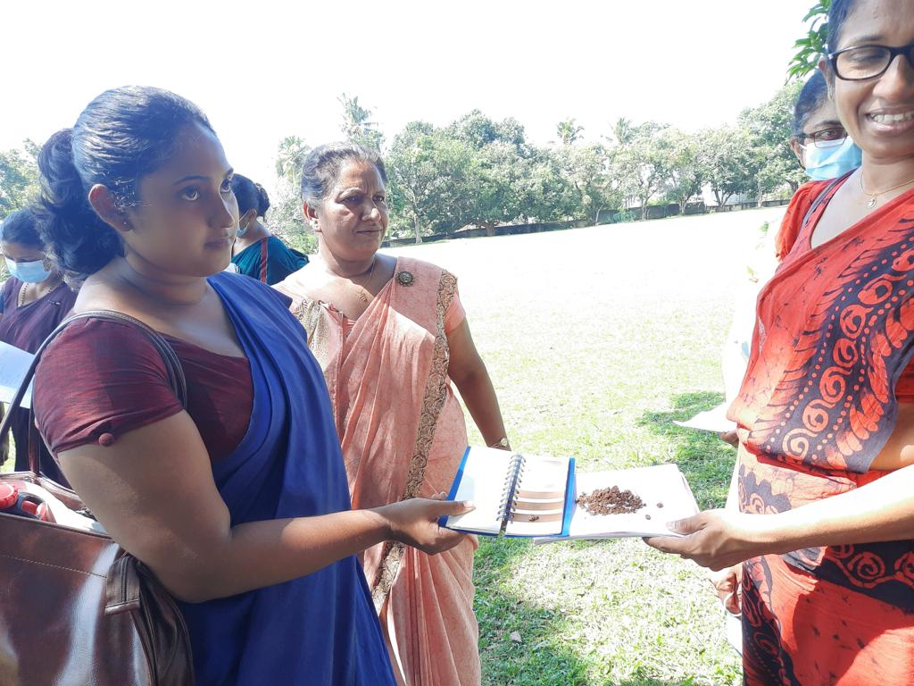
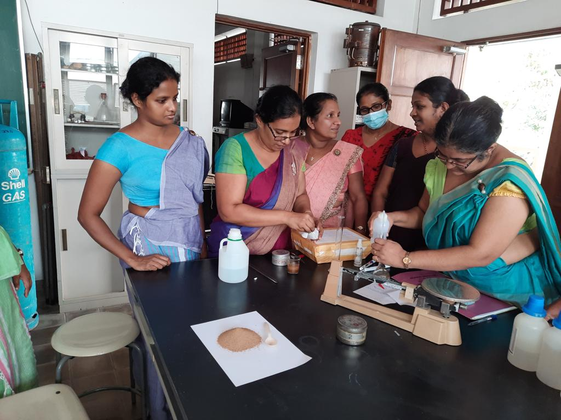

Slide 11
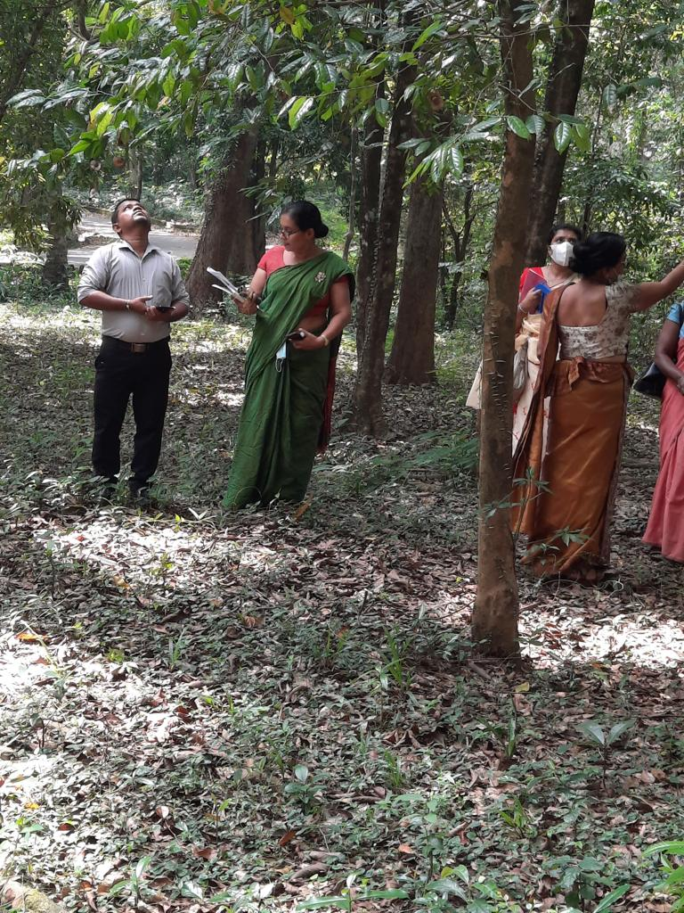
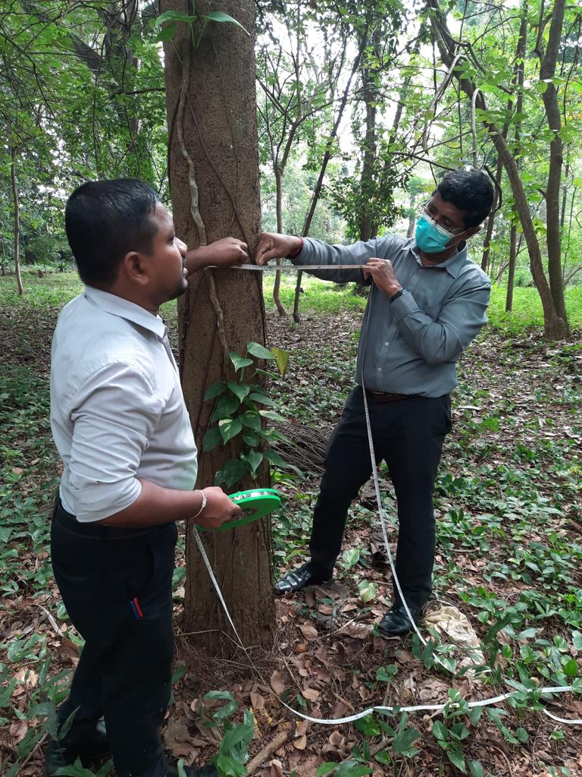
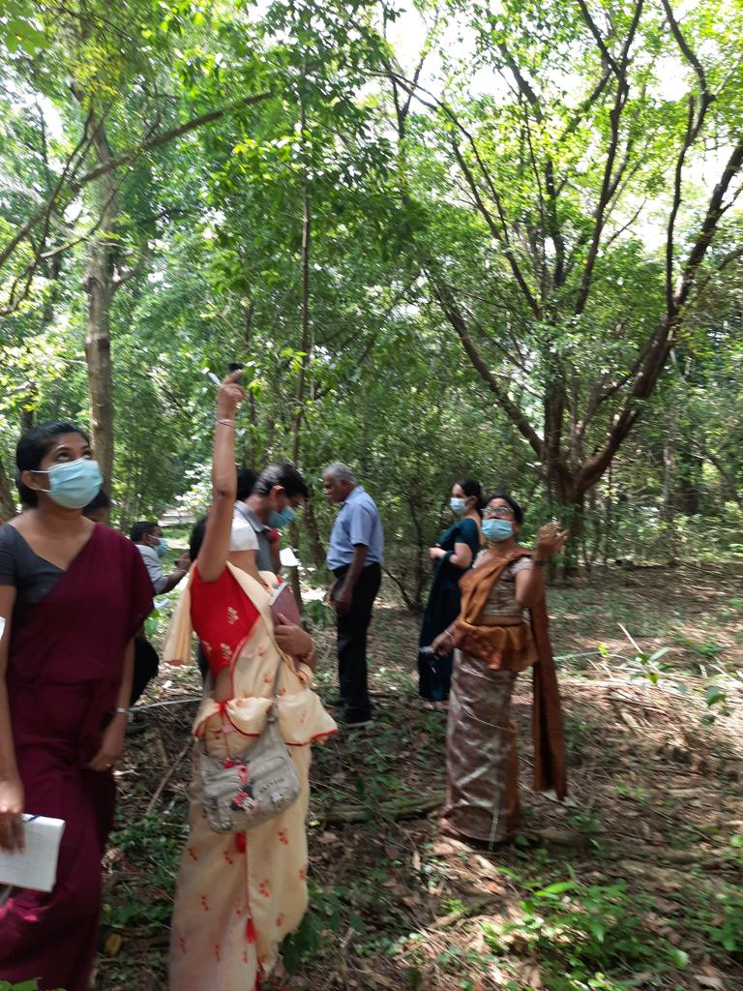
Biosphere

Slide 12
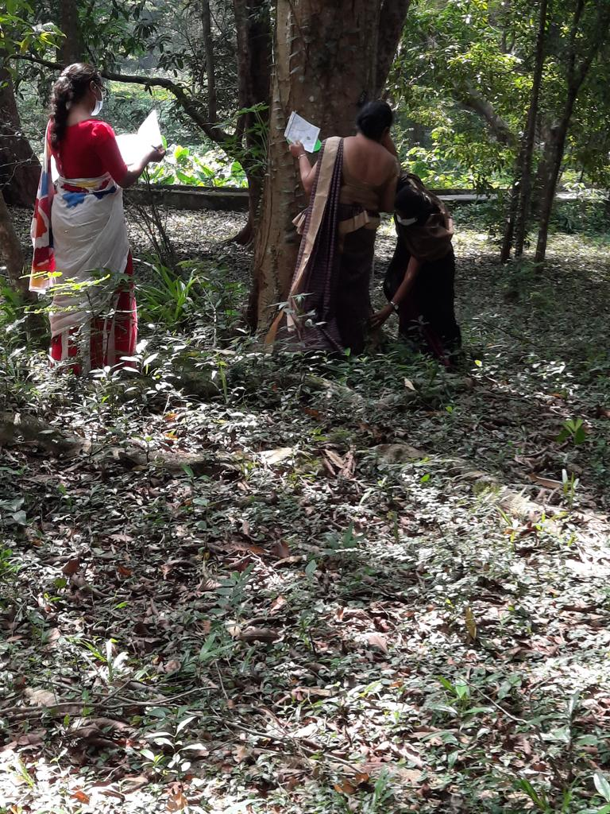

Slide 13
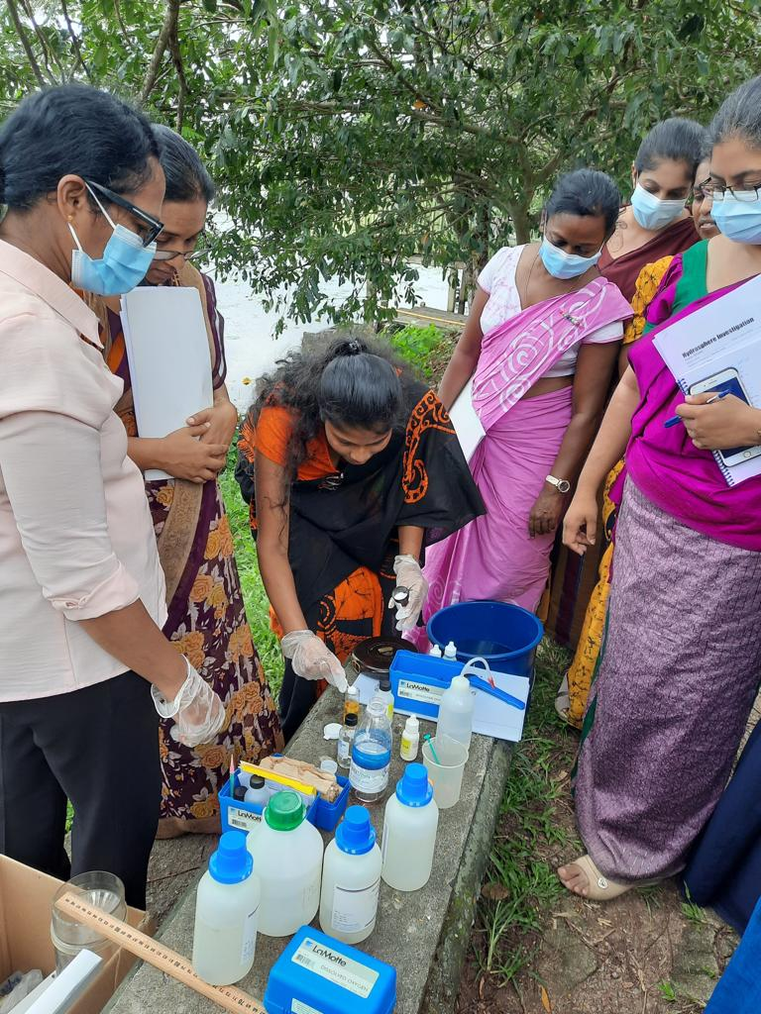
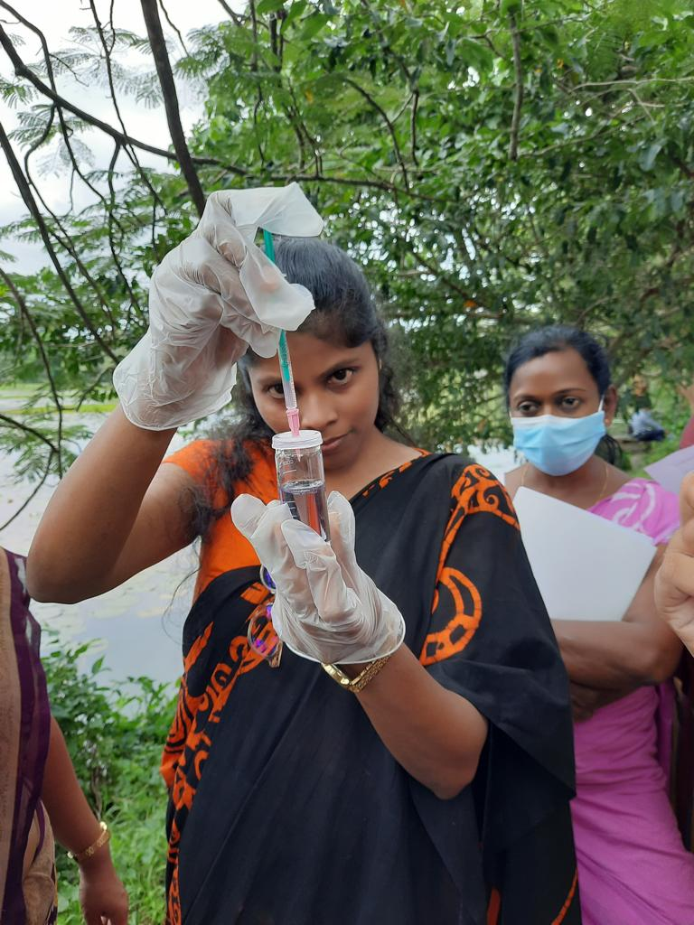
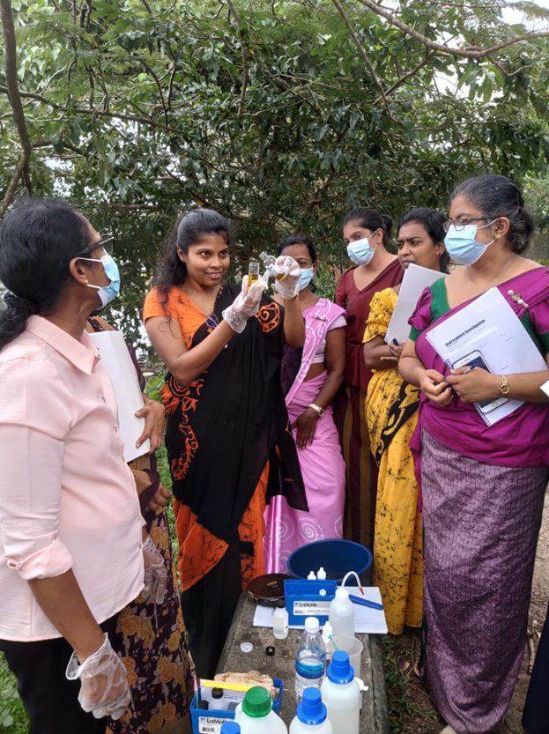
Hydrosphere

Slide 14
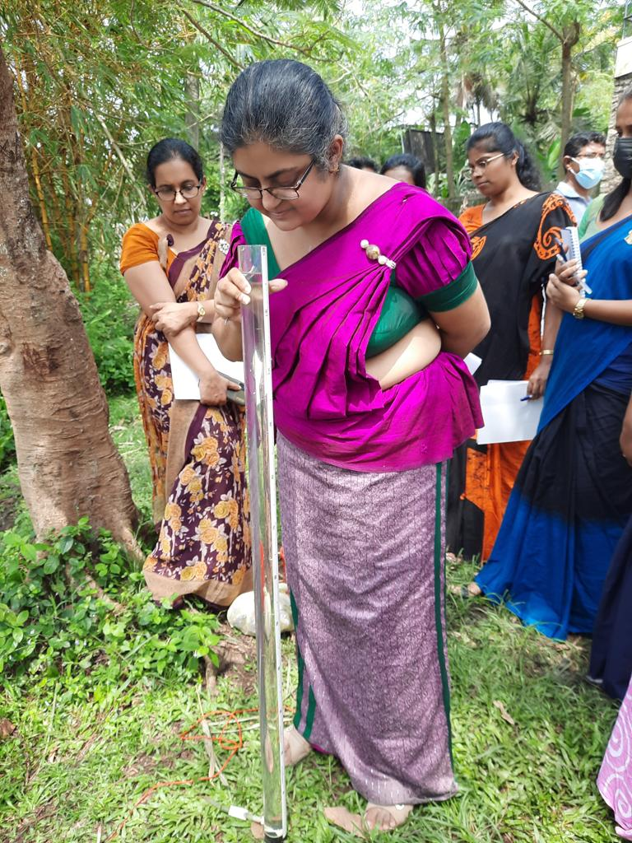
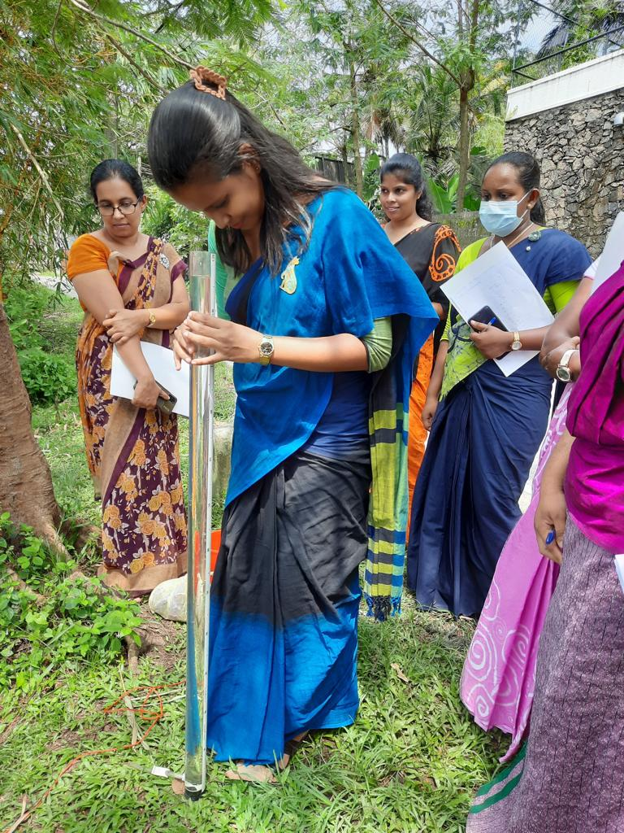

Slide 15
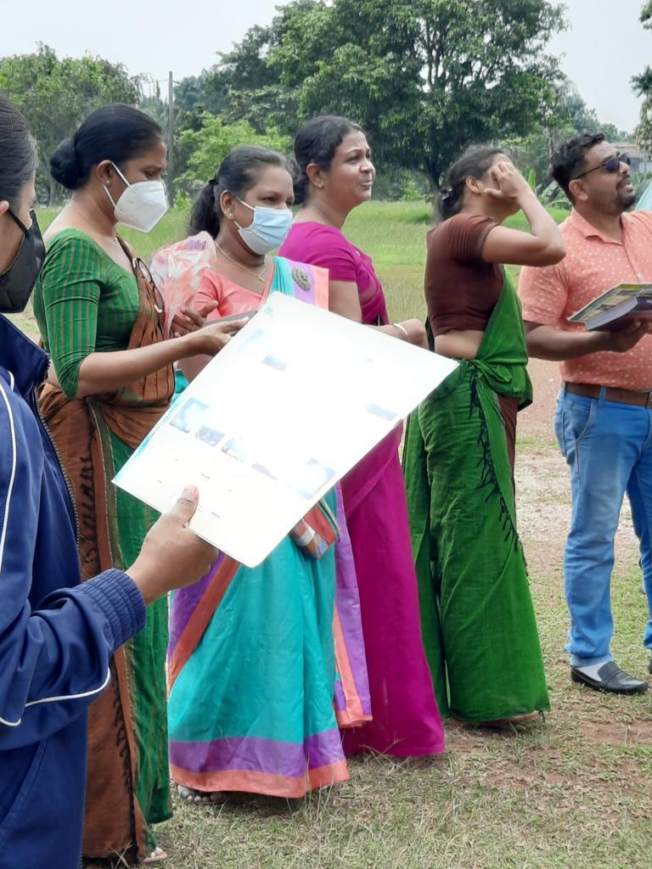
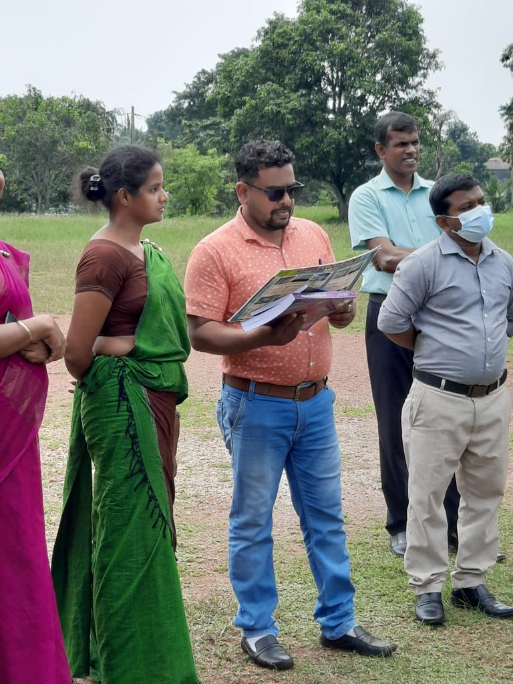
Atmosphere

Slide 16
Challenges
Covid 19 pandemic situation
Economic crisis in Sri Lanka
Increased charges for internet facilities
Lack of internet facilities for data entry
Lack/ limitation of capital allocation to purchase equipment
Outdated the existing equipment
Difficult to allocate extra time within school hours to conduct GLOBE protocols

Slide 17
Way Forward
Provide GLOBE equipment to schools
Promote GLOBE Societies in schools
Provide financial assistance to build weather units in schools
Continuation of student research projects evaluation programme
Conduct national GLOBE learning expedition

Slide 18
Way Forward
Strengthening elementary GLOBE for primary students
Expanding student project work through the Environmental Pioneer programme
Commemoration of special Environmental days with GLOBE teachers & students. Ex. Wetland Day, Water Day, Environment Day, Earth Day etc.
Contribution of regional collaborative projects

Slide 19
Thank You

